Slide 1

BINUS University and Internationalization
International Office
21 February 2014 | Tsukuba, Japan

Slide 2
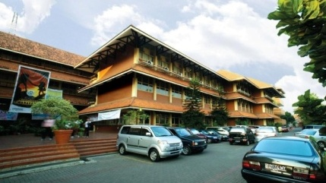
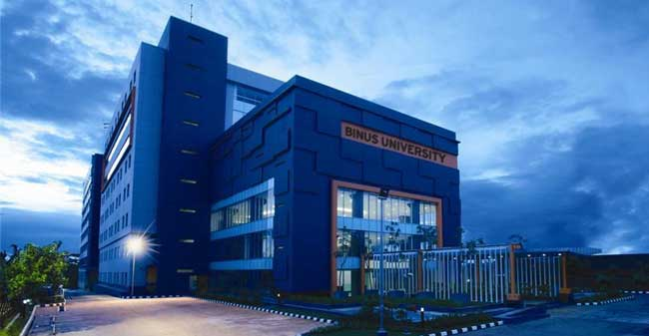
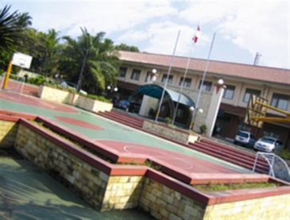
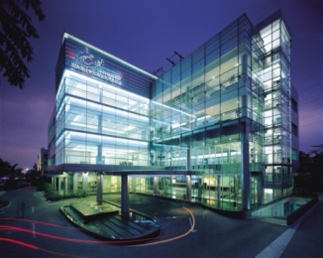
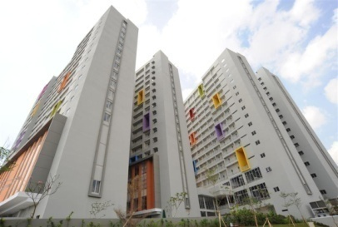
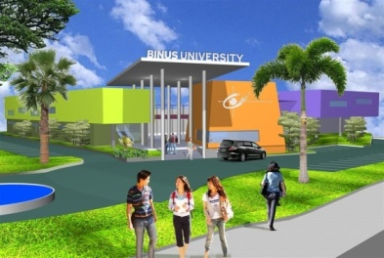
A Brief of
BINA NUSANTARA
and BINUS UNIVERSITY

Slide 3
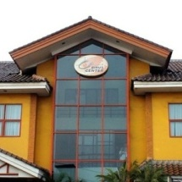
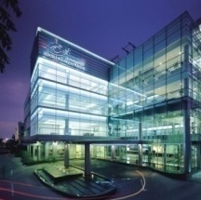
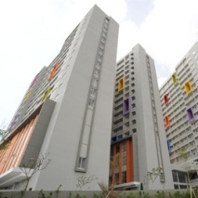
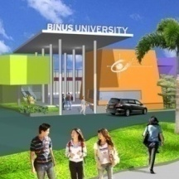
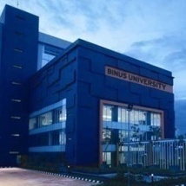

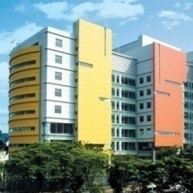
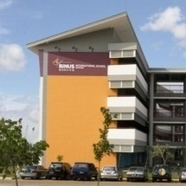
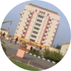
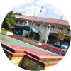

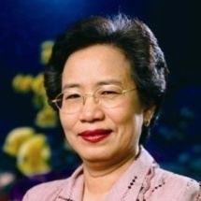
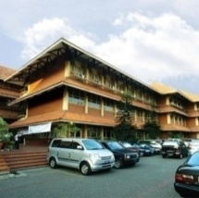
KEY MILESTONES
BINUS School Serpong
2007
BINUS School Simprug
2003
BINUS International
2001
BINUS University
Alam Sutra
2011
BINUS Center
2000
BINUS Square of Residence
2010
UNIVERSITAS
BINA NUSANTARA
1996
STMIK
BINA NUSANTARA
1987
1981
Akademik Teknik Komputer

Slide 4
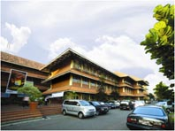
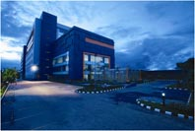
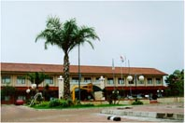

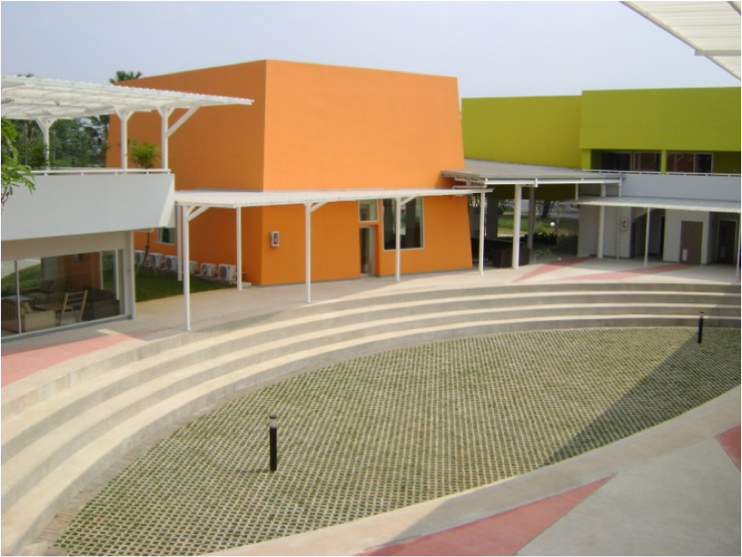
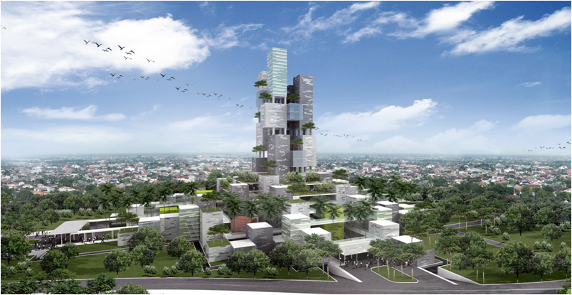
BINUS UNIVERSITY CAMPUSES
SYAHDAN Campus
ANGGREK Campus
KIJANG Campus
JWC Campus
ALAM SUTERA Campus
ALAM SUTERA Campus (2014)

Slide 5

Fact Numbers
70.938 alumni
26.599 active students
1.390 active lecturers
33 programs

Slide 6


DEPARTMENT & PROGRAMS
Economics & Communication
Accounting & Finance
Hotel Management
Marketing Communication
    Public Relation
    Broadcasting
    Digital Journalism
Engineering
Architecture
Civil Engineering
Computer Engineering
Industrial Engineering
Humanities
Chinese
Japanese
English
Psychology
Business Law
International Relation
Business Management
Management
International Marketing
International Business Management
Management &Information Systems
Management & Industrial Engineering
Computer Science
Computer Science
Mobile Application & Technology
Game & Technology
Computer Science & Mathematics
Computer Science & Statistics
Information System
Information Systems
Accounting Information Systems
Information Systems & Accounting
Computerized Accounting
Design
New Media
Animation
Creative Advertising
Interior Design
Business Management
Accounting and Finance
Management
    International Business
    Hospitality & Tourism Management
Marketing
Creative Media & Technologies
Computer Science
Information Systems
Graphic Design and New Media
    Fashion Management
    Fashion Design
Media & Communication
    Communication
    Film

Slide 7



Collaboration with Foreign Universities
EUROPE
AMERICA
ASIA
AUSTRALIA
77
UNIVERSITIES
4
CONTINENTS
COUNTRIES
25
7

Slide 8
A Brief of
BINUS International Office

Slide 9
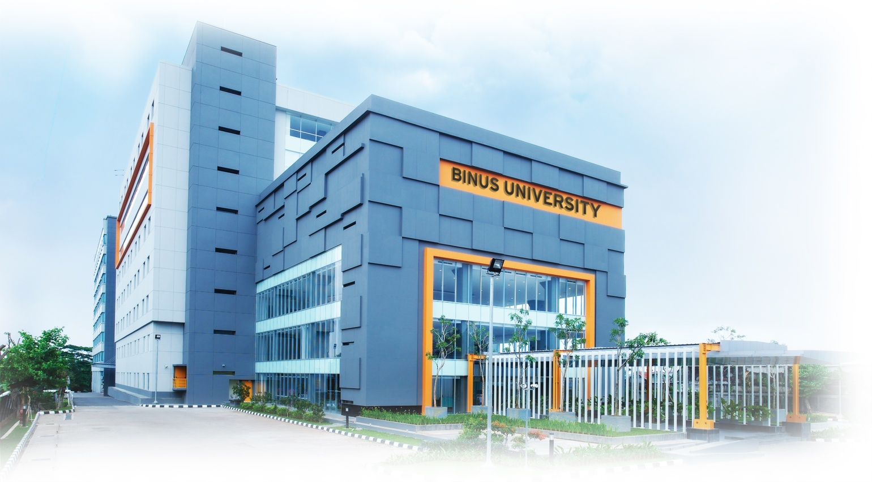
IO Background
BINUS UNIVERSITY Vision
A world-class university
in continuous pursuit of innovation and enterprise
BINUS UNIVERSITY Quality Objective:
20% of active students gain international experience during their period of study
1 of 3 graduates becomes an entrepreneur or working in a global organization

Slide 10

IO Functions & Services
Functions
Consolidate all potential Student & Faculty mobility programs & activities
Identify & initiate Student & Faculty mobility programs & activities
Promote all Student & Faculty mobility programs & activities
Facilitate all Student & Faculty mobility programs & activities
Services
Academic
  Academic & courses registration
  Advisory
Operational
  Guidance and general inquiries (living, accommodation, etc)
  Visa and legal advice
Student activities
  Orientation, Pre-departure briefing
  Gathering, cultural activities
  Advisory
  ibuddy, chaperone

Slide 11
Programs & Activities
INBOUND & OUTBOUND Mobility Execution
Program Campaign & Recruitment
Student Mobility & Advisory
Communication & Events
International Mobility & Recruitment
Student Relations & Advisory
Full Degree: International Recruitment
Academic Advisory
Full Degree: Admission & Settlement
Communication & Branding (internal & external)
Promotion Materials & Events
International Experience Activities

Slide 12
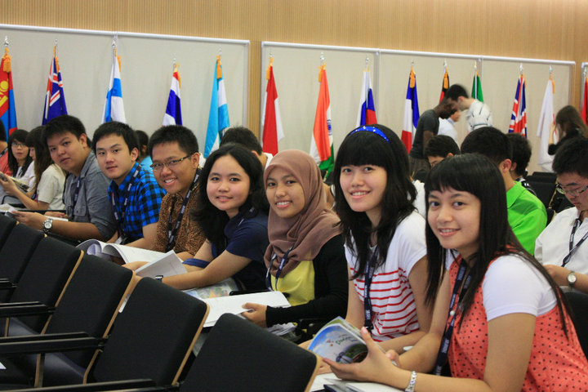
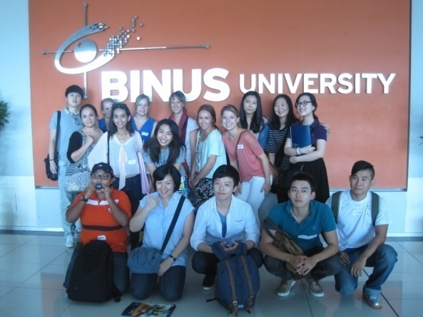
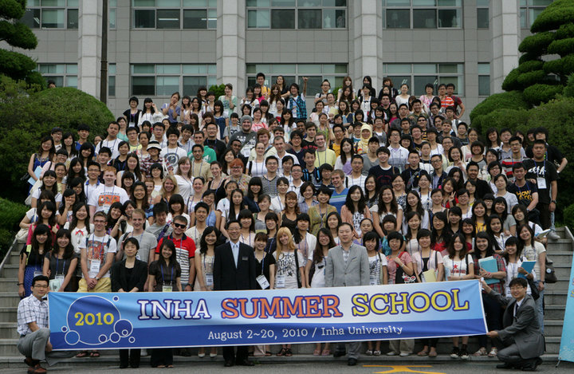
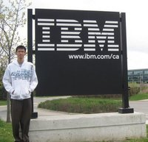
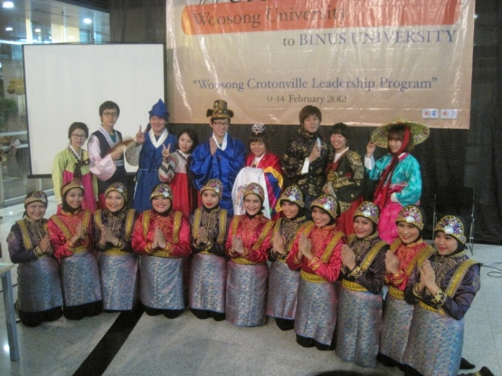
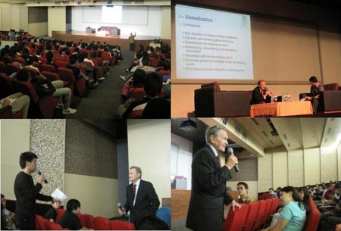
Programs & Activities
Twinning Program
Student Exchange
Internship
Short Course
Short Visit / Study Tour
Visiting Professor/Guest Lecturer
International Conference/Seminar
Video Conference

Slide 13
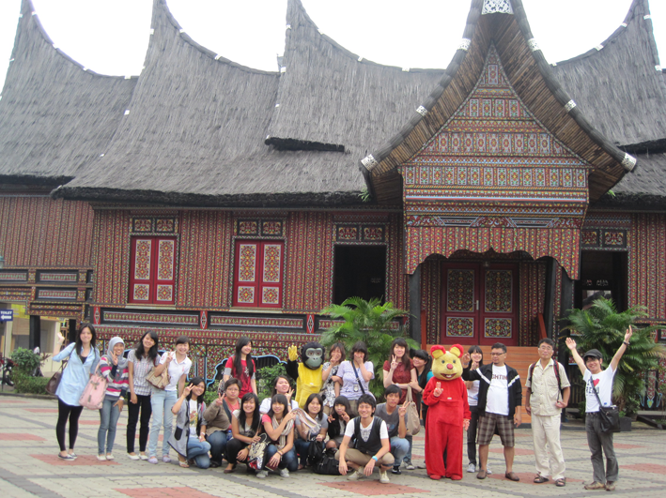
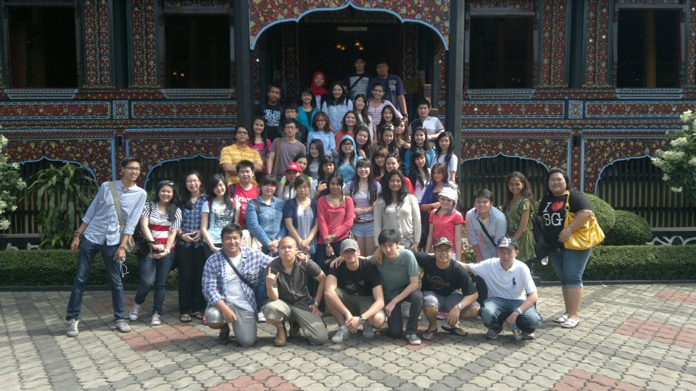
International Student Activities
Orientation
BIPA (Bahasa Indonesia untuk Penutur Asing – Indonesian for Foreigners) Program
Cultural Activities
Farewell Party

Slide 14
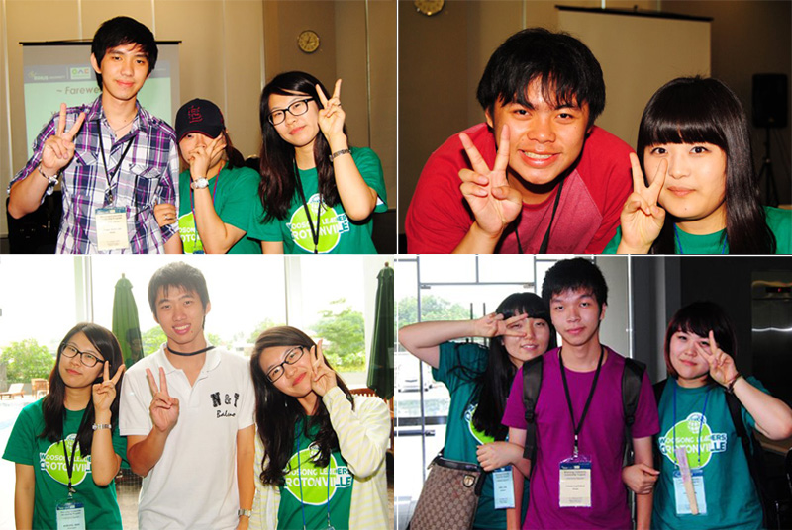
BINUS STAR & iBuddy Program
STAR Program is abbreviation of
Student Transnational Ambassador Program.
It is a program that focuses on BINUS University students who would like to have an international experience through internationalization programs of BINUS University
iBuddy program pairs new international students with current students who provide the friendly face, helping hand, and first BINUS friendship for new arrivals.
iBuddies can also offer linguistic support, cultural guidance and information about life at BINUS University

Slide 15
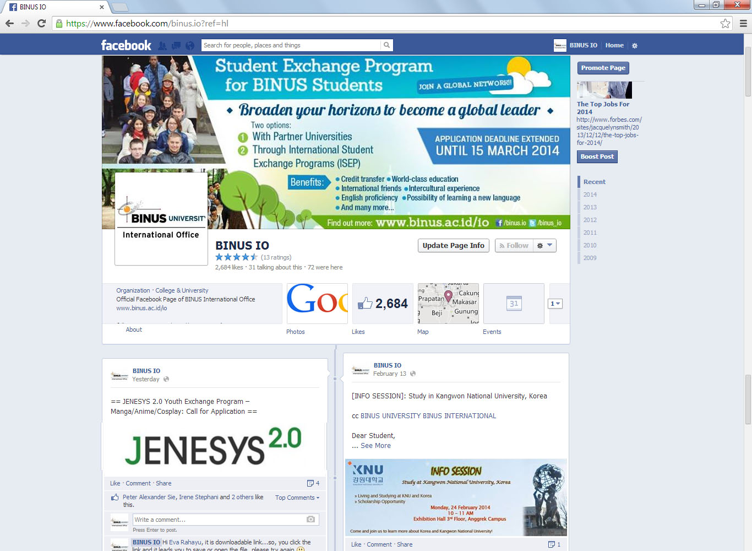
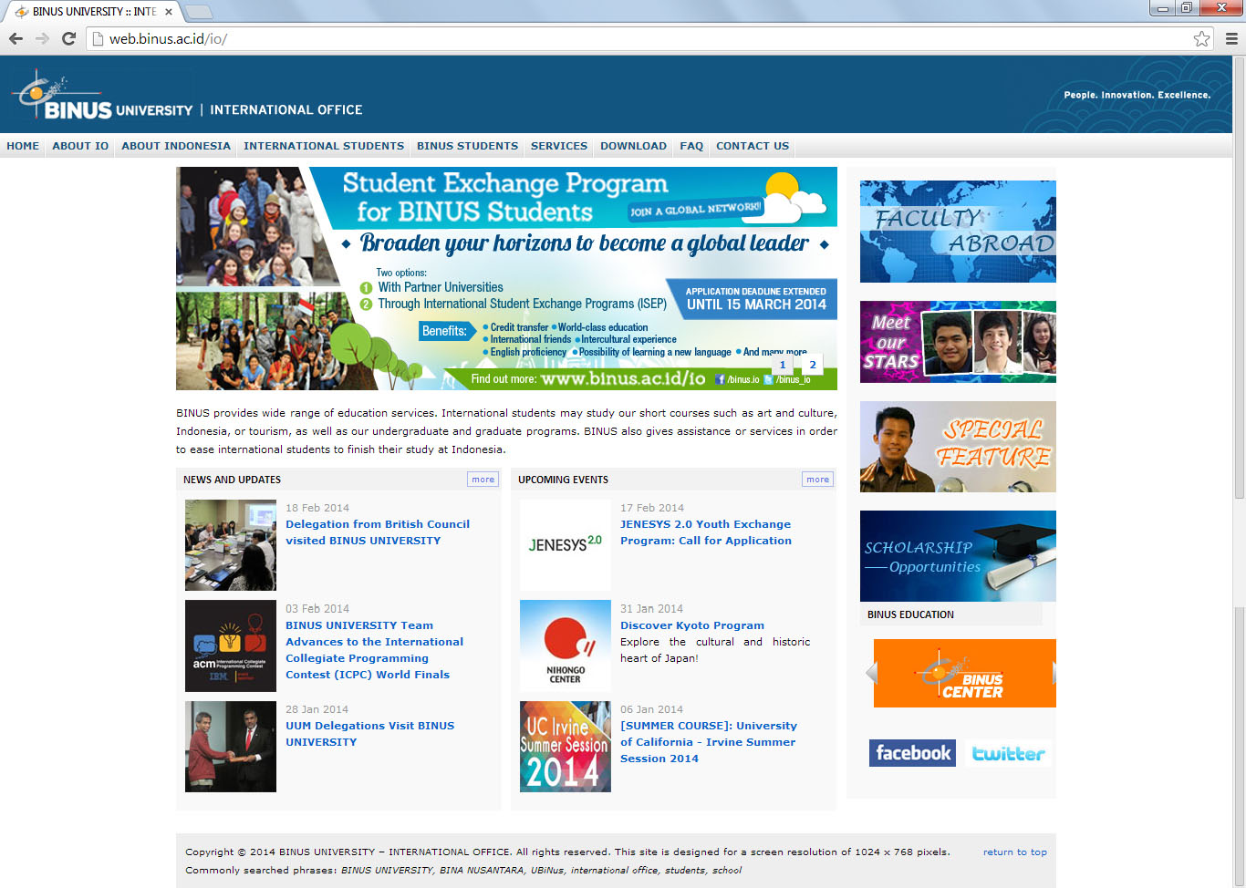
IO Website (www.binus.ac.id/io)
IO Facebook (www.facebook.com/binus.io)

Slide 16
Campus Facilities
Classrooms, Laboratories, Library
Auditorium, Function rooms, Student Lounging areas, Food Court
BINUSIAN Card-Flazz
BINUS SQUARE – Hall of Residence

Slide 17


BINUS Square – Hall of Residence

Slide 18

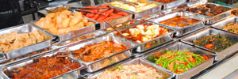

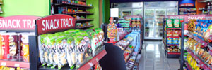

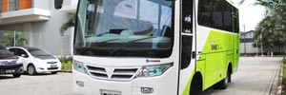
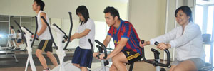

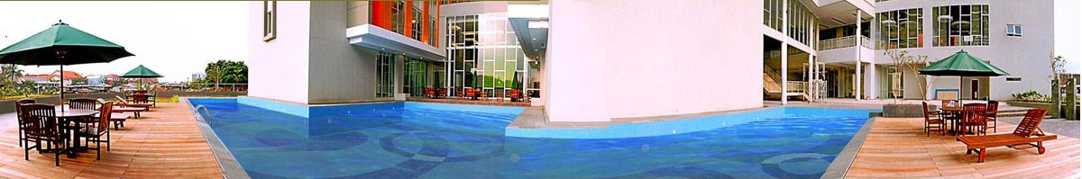
BSQ Facilities
Lounge
Cafetaria
Reading Room
24-hours minimart
Shuttle services
Games Area
Security & CCTV
Gym & Sports Area

Slide 19
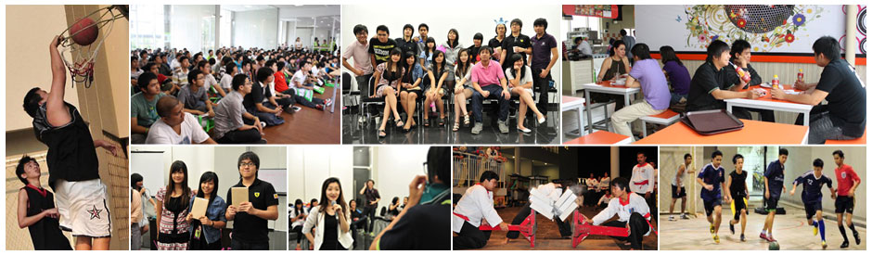
BSQ Boarders Activities
A wide range of fantastic events to make memorable living experience
Events are organized by and for the boarders
Sports, recreational and mentoring activities to enhance leadership, entrepreneurship and employability skills.

Slide 20
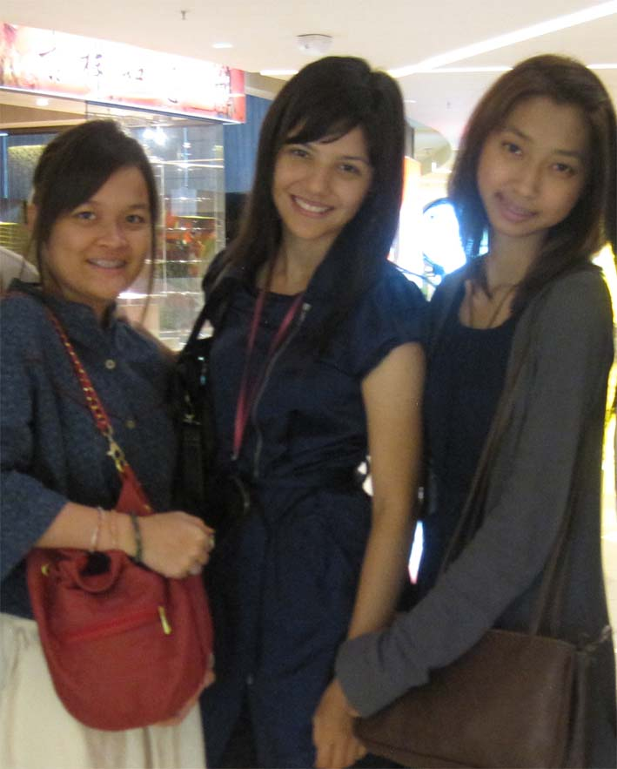
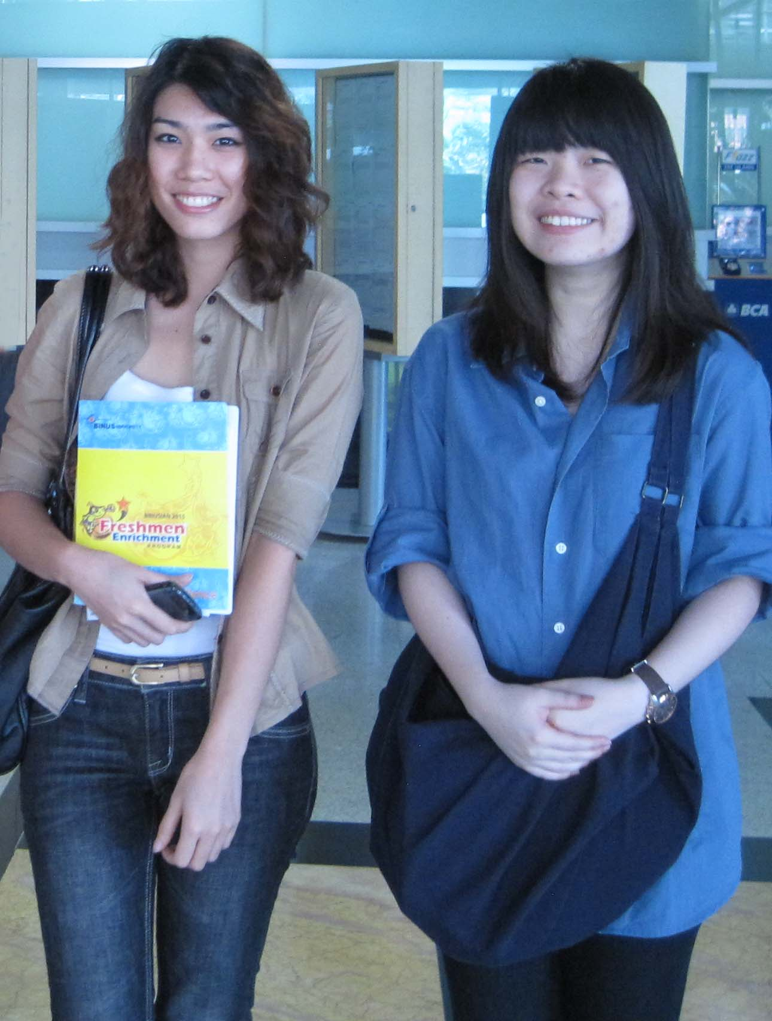
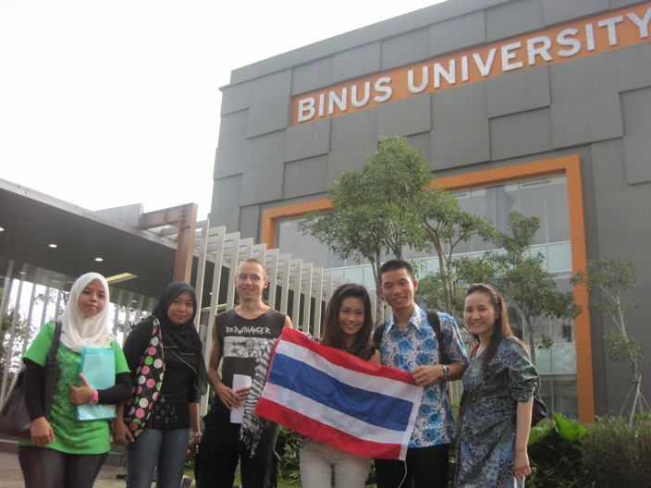

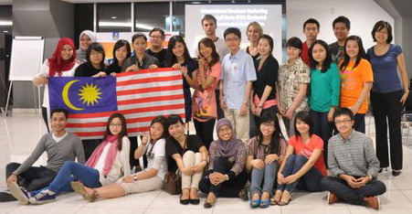
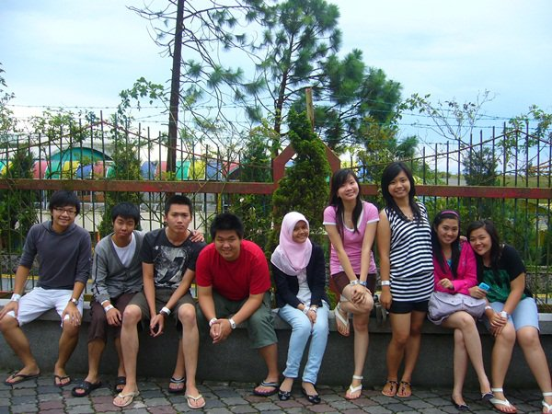
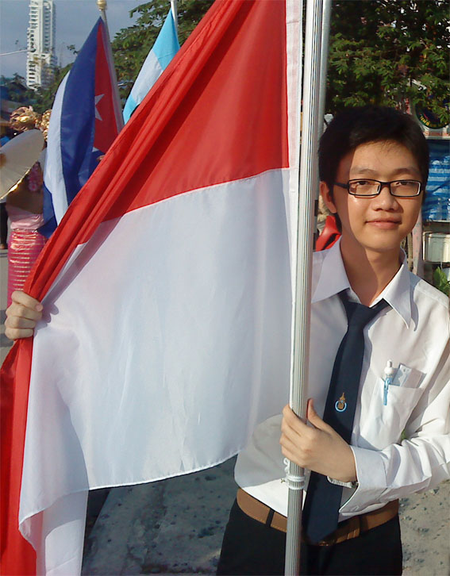
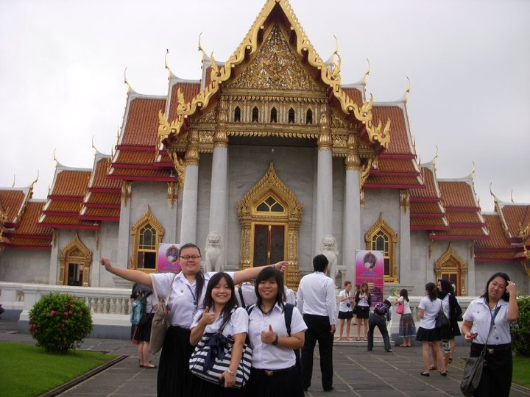
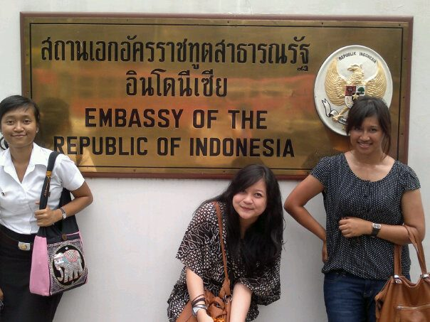
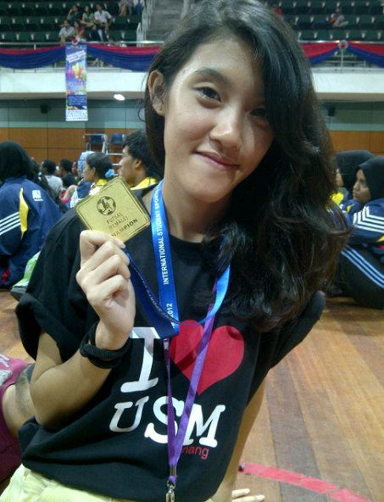
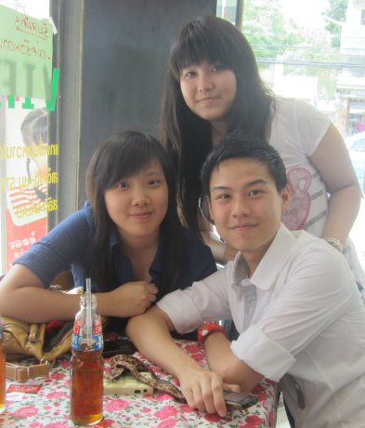



Slide 21



International Office
BINUS University
Jl. KH. Syahdan No. 9, Palmerah
West Jakarta 11480, Indonesia
T. (+62-21) 534 5830 #2172
E. io@binus.edu
W. www.binus.ac.id/io
binus.io
@binus_io

Slide 22
Thank You

